Slide 1
Sound Frequency Analyzer with LCD and LED Display
Done by:
Mariam Ayman – 120200094
Toqa Alaa - 120200032

Slide 2
Overview: The system measures the sound intensity using an analog input, displays the intensity value on an LCD, provides visual feedback through LEDs to indicate the intensity level, and transmits the measured value through UART for additional processing or monitoring.

Slide 3
Components

Slide 4
ATmega328 Microcontroller
Sound Sensor
LCD Display
Potentiometer
LEDs
Three Carbon Resistors 220kΩ
Power Supply

Slide 5
Explanation

Slide 6
1- When the system is powered on, the sensor measures the sound intensity in the environment.
2- The sound sensor captures the incoming sound waves and converts them into an electrical signal which is then fed into the analog-to-digital converter (ADC) of the microcontroller.
3- The ADC converts the analog voltage value into a digital representation that corresponds to the sound intensity level.
4- Once the sound intensity is obtained as a digital value, the system proceeds to display it on the LCD. The LCD display is initialized and the message "Sound intensity:" is shown on the first line and the measured sound intensity value is then printed on the second line of the LCD.

Slide 7
5- Simultaneously, the microcontroller evaluates the measured sound intensity to determine the appropriate LED indication. This is typically done using conditional statements (if-then) to compare the sound intensity value against predefined ranges and based on the evaluated condition, specific LEDs connected to the microcontroller's pins are turned on.
6- After updating the LED indication, a delay is introduced to allow sufficient time for the LEDs to remain which provides visible indication and stability.
7- The system continues to repeat this sequence, continuously measuring the sound intensity, updating the LCD display, controlling the LEDs, and introducing delays.

Slide 8
Thus, allowing the user to monitor the sound intensity level in real time and observe the corresponding LED indication, providing a visual and numerical representation of the sound intensity in the environment

Slide 9
Steps

Slide 10
Initialization:
During the setup, the LCD is initialized, and a message "Sound intensity:" is displayed on it. The analog reference is set to the internal 2.56V reference. Pin directions are set, and UART communication settings are configured.
Sound Intensity Measurement:
In the loop() function, the analog value from the sound sensor (connected to A0) is read using the readADC() function. The measured intensity value is then displayed on the LCD.
LED Indication:
Depending on the measured intensity value, different LEDs connected to pins PB0, PB1, and PB2 are turned on or off. The LED output indicates the intensity level of the sound. The specific intensity ranges and LED indications can be understood from the code's conditional statements.

Slide 11
Delay and Loop:
After the LED indication, a delay of 500 milliseconds (0.5 seconds) is implemented using the delay500ms() function. This creates a pause between each measurement and LED update. The loop then repeats, continually measuring the sound intensity, updating the LCD, and controlling the LEDs accordingly.
UART Communication:
The measured intensity value is also sent through UART (serial communication) using the UART_puts() function. The value is transmitted as a string and can be received by an external device or logged for further analysis.

Slide 12
Demo

Slide 13
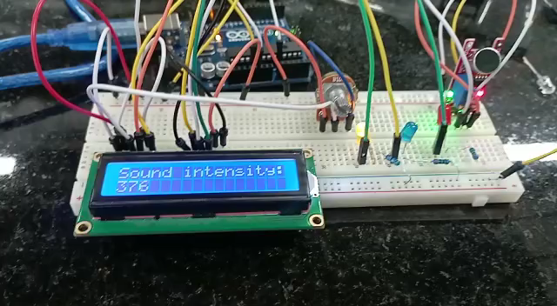

Slide 14
Demo Illustration:
- First, the yellow led is on as the sensor is reading values within the range from 300 Hz to 400 Hz.
- Second, the blue led becomes on when we introduced a higher sound frequency in the range from 400 Hz to 700 Hz
- Finally, the green led becomes on when the frequency becomes even higher in the range > 700 Hz, typically, it reached the sensor threshold as displayed on the LCD which is equal to (1023 Hz)

Slide 15
Thank You!

